Slide 1
Lecture 9: Strings
Reading: Chapter 4, 4.4 - 4.5

Slide 2

The String Type
You’ve already been using it!
Uses the reserved word String.
Whatever you assign to a String variable must be enclosed in quotes.
Unlike char, double, int, float, byte, short, and long, String is not a primitive type.
String is a class in the Java library (like Math).

Slide 3

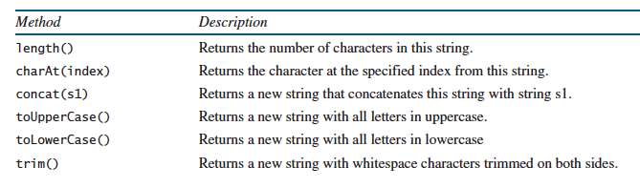
String is a class ... so what?
This means that there are methods that you can use to manipulate the text.
These methods are similar to the ones you use with the Character or Math class.

Slide 4
String Length
With the Character and Math classes, we used Character.isDigit(‘a’) or Math.pow(2,3) and we used the name of the class.
With Strings, we apply the method directly to the String variable with a dot.
String message = “Happy Birthday”; int totalCharacters = message.length();
S.O.P.L(“Length is: ” + totalCharacters);
How many characters are in “Happy Birthday”?
14
A space is a character.

Slide 5

The charAt method
What if you want a particular character from a String, like the first or last character in the String?
Use charAt
Use it like you do with the length method by applying it directly to a variable after a dot.
charAt requires a value inside the parentheses (called a parameter).
This value is the location of the character that you want (aka the index).
Notes:
Charr race from Golarion in the Pathfinder game.

Slide 6
How do you specify the location in a string?
H | a | p | p | y |  | B | i | r | t | h | d | a | y
0 | 1 | 2 | 3 | 4 | 5 | 6 | 7 | 8 | 9 | 10 | 11 | 12 | 13
Java starts counting positions at 0.
The first position is 0.
The last position is equal to the total number of characters (the length)
minus 1 (length - 1).

Slide 7
Example
H | a | p | p | y |  | B | i | r | t | h | d | a | y
0 | 1 | 2 | 3 | 4 | 5 | 6 | 7 | 8 | 9 | 10 | 11 | 12 | 13
String message = “Happy Birthday”;
System.out.println(message.charAt(0));
System.out.println(message.charAt(13));
System.out.println(message.charAt(5));
System.out.println(message.charAt(8));
Output Window
H
y
r

Slide 8
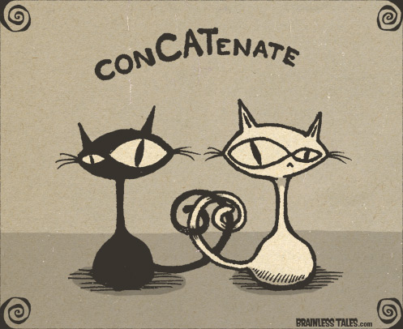

Concatenating Strings
You can join two strings together using the concat method.
However, programmers used this so much that they got tired of typing concat.
So, the plus operator will concatenate (join) two strings together.

Slide 9

Example
Which one would you rather type over and over??
String m1 = “Happy “;
String m2 = “Birthday”;
S.O.P.L(m1.concat(m2));
String m1 = “Happy “;
String m2 = “Birthday”;
S.O.P.L(m1 + m2);
Output Window
Happy Birthday

Slide 10
What if you wanted to convert a whole String to upper or lower case?
The Character class has two methods that will do this.
But going character by character is TEDIOUS.
The String class has two methods that will do this. Yay!
String msg = “Welcome”;
S.O.P.L(msg.toUpperCase());
S.O.P.L(msg.toLowerCase());
Output Window
WELCOME
welcome

Slide 11
Reading String Input from the Console
There are two methods you can use with Scanner (i.e. your keyboard variable) that can read in input as a String.
next(): Reads input until it encounters whitespace (i.e. a space). Then, the cursor hangs out on that line. It does not go to the next line. This is good for reading one word.
nextLine(): Reads input until it encounters the end of a line (which is indicated by a special character that you don’t see). Then the cursor goes to the next line.
There is NO method available to read in a single character. If you read in one character, it must still be stored as a string because next() and nextLine() read input as strings.
Notes:
Think of these like print and println

Slide 12
Examples
Scanner keyboard = new Scanner(System.in);
String s1, s2;
S.O.P(“Enter a message: “);
s1 = keyboard.next();
s2 = keyboard.next();
S.O.P.L(“s1 is “ + s1);
S.O.P.L(“s2 is “ + s2);
Output Window
Enter a message: Happy Birthday
s1 is Happy
s2 is Birthday
Scanner keyboard = new Scanner(System.in);
String s1;
S.O.P(“Enter a message: “);
s1 = keyboard.nextLine();
S.O.P.L(“s1 is “ + s1);
Output Window
Enter a message: Happy Birthday
s1 is Happy Birthday

Slide 13
What if you want to get a character as input and store it as a character type??
Scanner keyboard = new Scanner(System.in);
String s1;
S.O.P(“Enter a message: “);
s1 = keyboard.nextLine();
char letter = s1.charAt(0);
S.O.P.L(“character is “ + letter);
Output Window
Enter a message: A
character is A

Slide 14
Getting a portion of a String
A substring is a portion of a String.
You need to know the starting and ending indices of the portion that you want to isolate.
The substring method needs two parameters.
The first one is the index that you’re going to start at.
The second one is 1 + index that you want to end at.

Slide 15
Example
Assume that you have the following:
String msg = “Happy Birthday”;
Isolate the word “Birth” from the String.
H | a | p | p | y |  | B | i | r | t | h | d | a | y
0 | 1 | 2 | 3 | 4 | 5 | 6 | 7 | 8 | 9 | 10 | 11 | 12 | 13
What is the index of B?
6
What is 1 + the index of h?
10 + 1 = 11
S.O.P.L(msg.substring(6, 11));

Slide 16

Note
You do not have to know Sections 4.47, 4.4.9 and 4.4.10 in your book (comparing strings, converting strings, finding a character in a substring.

Slide 17

That’s all for today folks!
Read Chapter 4, Sections 4.4 - 4.5

